Slide 1


“All Press is Good Press?”
Analysis on the Relation Between Subreddit Reviews and Steam Player Counts
Katherine O’Connor (KSO25), Alex Hertadi (AFH78), James Clark (JAC692)
Notes:
Katherine: There is a famous saying “all press is good press”. Is this actually true? The aim of our project is to analyze the association between the sentiment and count of subreddit engagement of a few specific video games and their Steam player counts. As per the applications of this project to the real world, we will attempt to measure video game sales via proxy through Steam player counts.

Slide 2



Project Goals:
We want to explore how the play-style design of the game (single-release, single release and DLC content, single-release and updates) correlates to reddit traffic and steam player counts of the games over time.
We want to determine the most important features for predicting Steam player counts. Specifically, we’re interested in how negative vs. positive subreddit comments and posts correlate with Steam player count.
single-release
Single-release and DLC content
Single-release and updates
Notes:
Alex

Slide 3
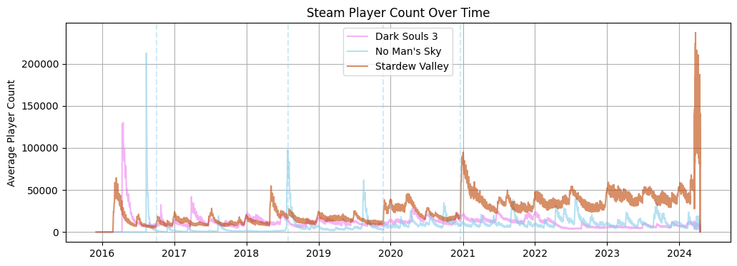
Can Reddit engagement impact player counts?
Input Features: (January, 2016 - May 2017)
Number of comments and posts;
Sentiment of comments and posts (i.e positive or negative);
Date of the comments and posts;
Average length of the comments and posts; and
Average score (upvotes minus downvotes) of the comments and posts
Output: Daily Steam Player Counts
Notes:
James: Our data is sourced from an academic torrents website and because of its size, is stored in .zst format. Our first step in EDA will be to download, decompress and extract all data relating to the above 3 subreddits. Our initial data set contained 363,227 reddit posts and 4,475,317 comments from the specified subreddits with 53 columns ranging from the actual text of the post, when it was created, the number of upvotes, and less useful details such as media embeddings and html assets. From the available information, we filtered the data and chose to focus only on the number of posts, number of comments per day, average score of posts per day (upvotes - downvotes), average length of the post, the date, and a sentiment score from NLTK (Natural Language Toolkit).

Slide 4
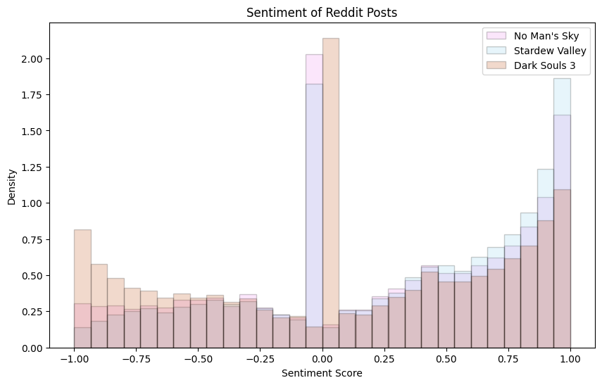
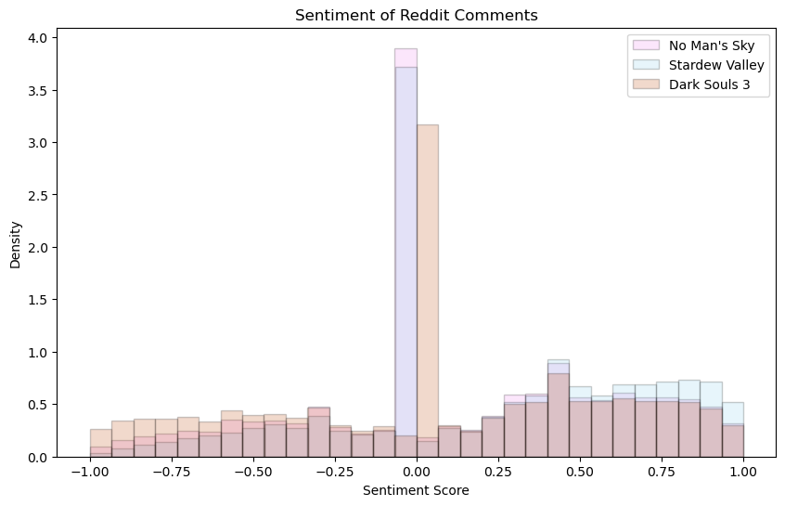
NLTK-VADER Sentiment Analyzer
Ex: From r/StardewValley
“"Don't get me wrong, I love farming and trading.. but gimme a sword and I'll be the happiest monster hunter you've ever seen. I'm so excited to gain skill and go through caves and mine through everything! GAH I'm so excited!!" → Compound Score: 0.9786
"Fishing is the only thing I hate in this game and I can't do it" → Compound Score: -0.5719
Notes:
Alex: Natural Language ToolKit(NLTK) is a popular library in Python used for Natural Language Processing (NLP). VADER also assigns an “intensity of sentiment” scores ranging from -1 to 1, where -1 to -0.05 is considered negative, -0.05 to 0.05 neutral, and 0.05 to 1 positive, on the input as a compounded sentiment score. This compound sentiment score is calculated by scoring not only the individual words, but also uses grammatical and syntactical rules of everyday language to adjust the scores.

Slide 5
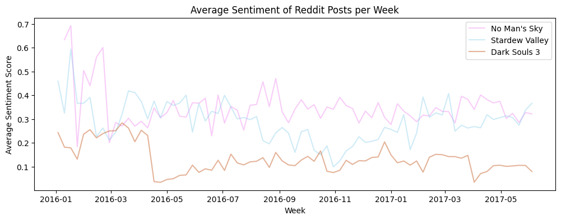
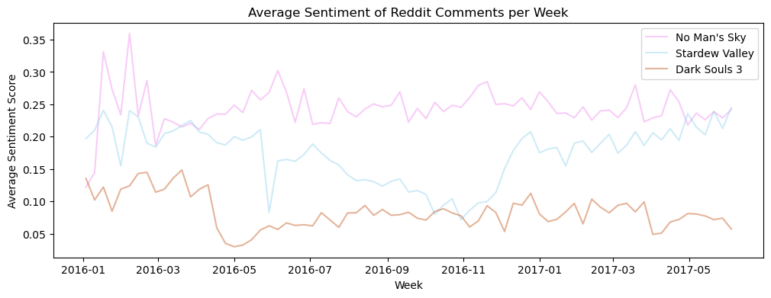
Sentiment of posts and comments positive on average
Across both posts and comments, sentiment is largely neutral, and biased towards positivity
Sentiment is higher for posts than for comments
Sentiment is lowest for Dark Souls 3 and highest for No Man’s Sky, contradictory to expectation
Notes:
Alex

Slide 6
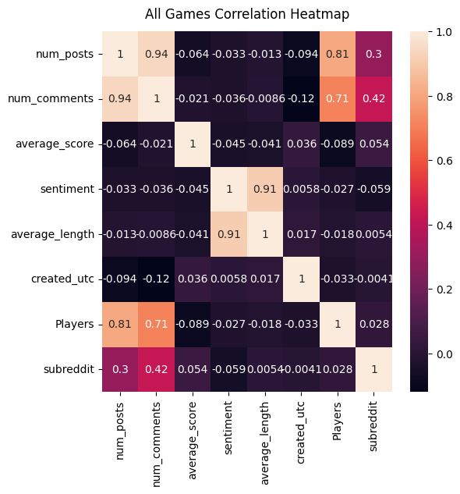
Only num_posts and num_comments indicating correlation with player count
Most variables have a very weak correlation with the player counts, regardless of the the game
num_posts varies with subreddits, though we will not use that as a direct variable in our modelling process
Only num_comments and num_posts hold a strong correlation with player counts
sentiment and average_length strongly positively correlated with each other, which suggests that NLTK categorises longer posts more positively
num_post and num_comments are strongly correlated logically, since comments needs posts to exist
Notes:
Alex

Slide 7
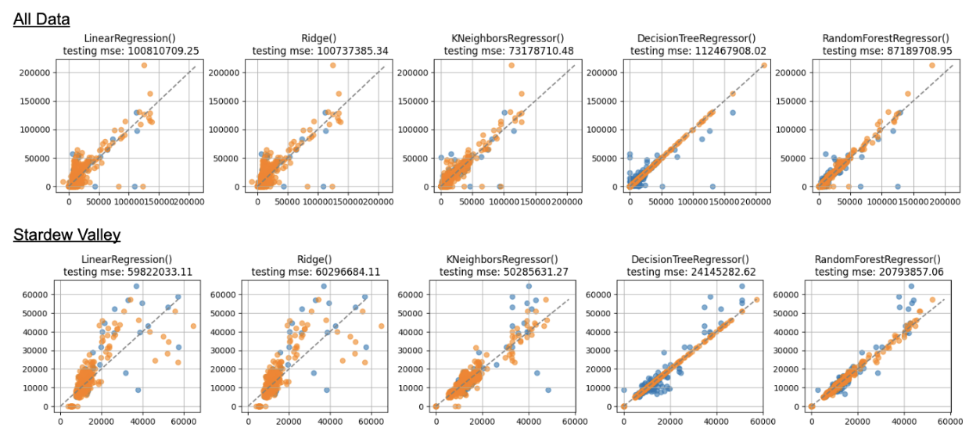
Try Models to Predict Steam Player Counts
…
Notes:
Katherine: We wrote a custom function to essentially try a bunch of different types of models and see what works. It applies sklearn linear regression, ridge regression, k-nearest neighbors regressor, decision tree and random forest models to the same seed of random training test splits. It then produces a scatter plot of the predicted values against the actual values. The values from the training dataset are plotted in orange and the test points are in blue.

Slide 8
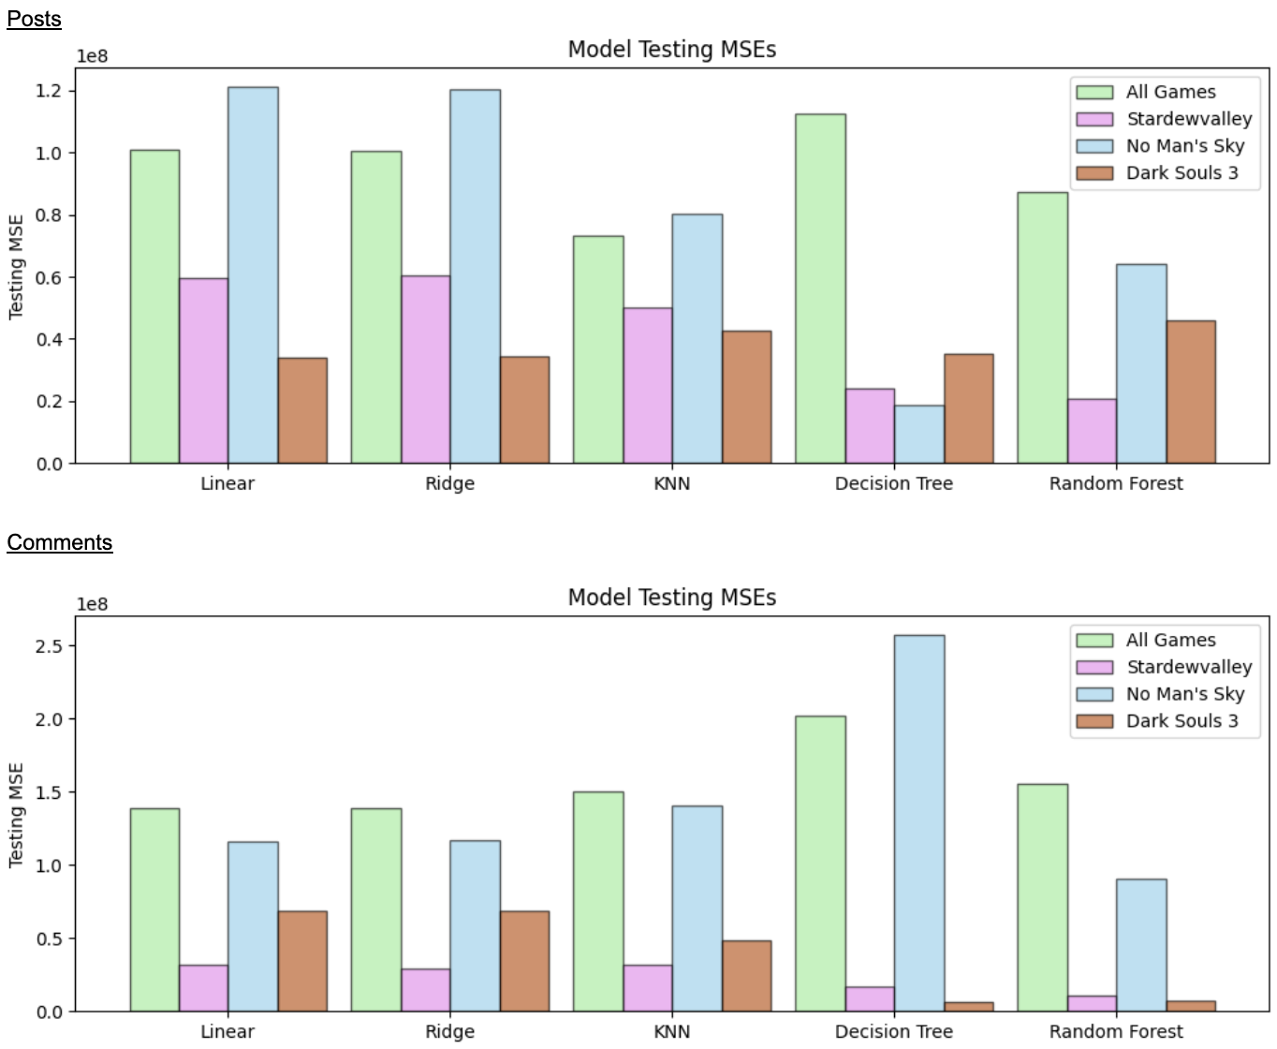
Random Forest model performed best overall
Linear and Ridge regression performed worst overall, though all models had a high MSE
Best model type was Random Forest for both, but Decision Tree performed very differently
Lower MSE for Decision Tree in some cases suggests that Random Forest may be convoluted
Chosen model to investigate further was Random Forest as it provided the overall lowest MSE across both posts and comments
For all games but Stardew Valley, optimal tree depth was around 10
Notes:
Katherine: We constructed models at the individual level per game and considering all of the chosen games together. Primarily we chose the best model based off of lowest testing MSE.

Slide 9
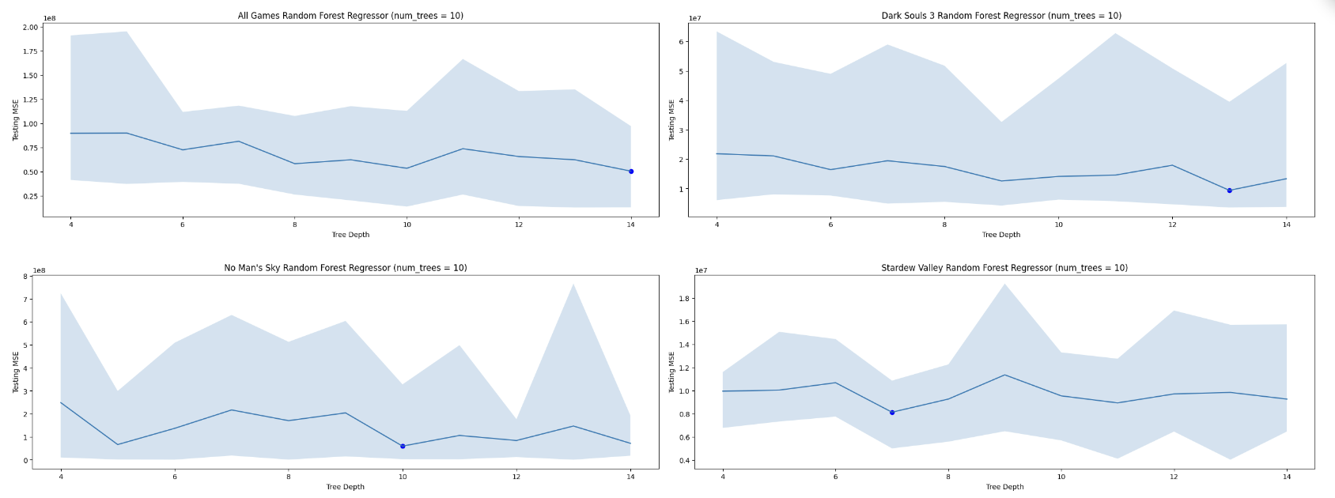
Hyper-parameter Tuning of Random Forest Regressors
Notes:
Katherine: We also attempted to improve the performance of the best performing model, the random forest regressors with hyper-parameter tuning of the maximum depth. In theory, this should prevent the models from overfitting and make them more generalizable. Unfortunately, we did not find significant model performance improvements from the empirical results.

Slide 10
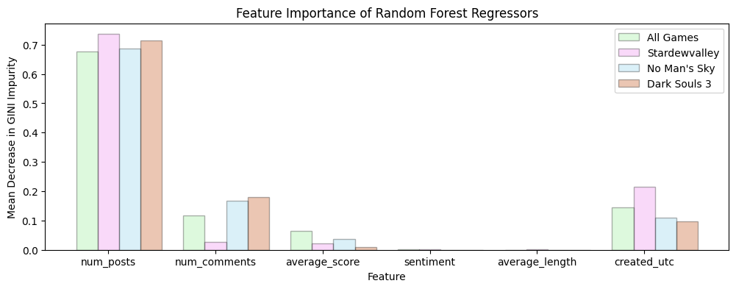
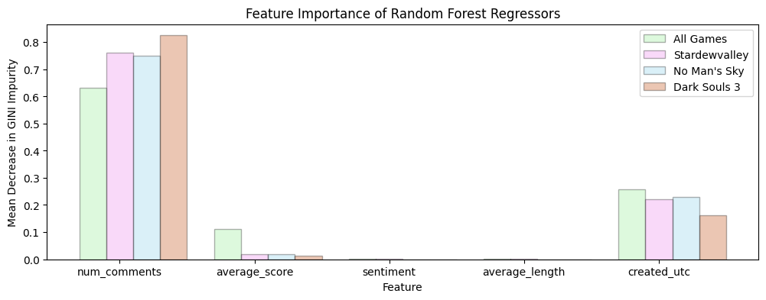
Number of comments and posts most important feature
num_posts and num_comments by far most important variables
sentiment and average_length are irrelevant and have little to no bearing on player count
created_utc is second most important feature, but this is logical and tracks with player count declines
Notes:
Katherine: Across all forms of models (whether that be at the individual or combined level) , num_posts and num_comments by far most important variables by mean decrease in GINI impurity. created_utc is second most important feature, but this is logical and tracks with player count declines. Unfortunately, sentiment and average_length proved fairly irrelevant (at least relative to the other features investigated) and have little to no bearing on player count. This was especially disappointing for our group because we found the natural language processing aspects of investigating subreddit content to be one of the most interesting parts of the project and would like to investigate how it could be improved.

Slide 11
Conclusion: “All Press is Good Press” is True ?
“All press is good press” is true pertaining to subreddit and steam player counts based on our analysis.
Little to no correlation between sentiment or average score and player count.
Volume of content on a games subreddit is the largest indicator of player count, but that is to be expected
No discernable difference between the play-style design of the game (single-release, single release and DLC content, single-release and updates)
Unclear whether subreddit drives player count or player count drives subreddit activity
Notes:
James

Slide 12
Notes:
James

